Slide 1
Warung Pintar
Business Intelligence for FMCG Empowerment
Sunday, 14 November 2021

Slide 2
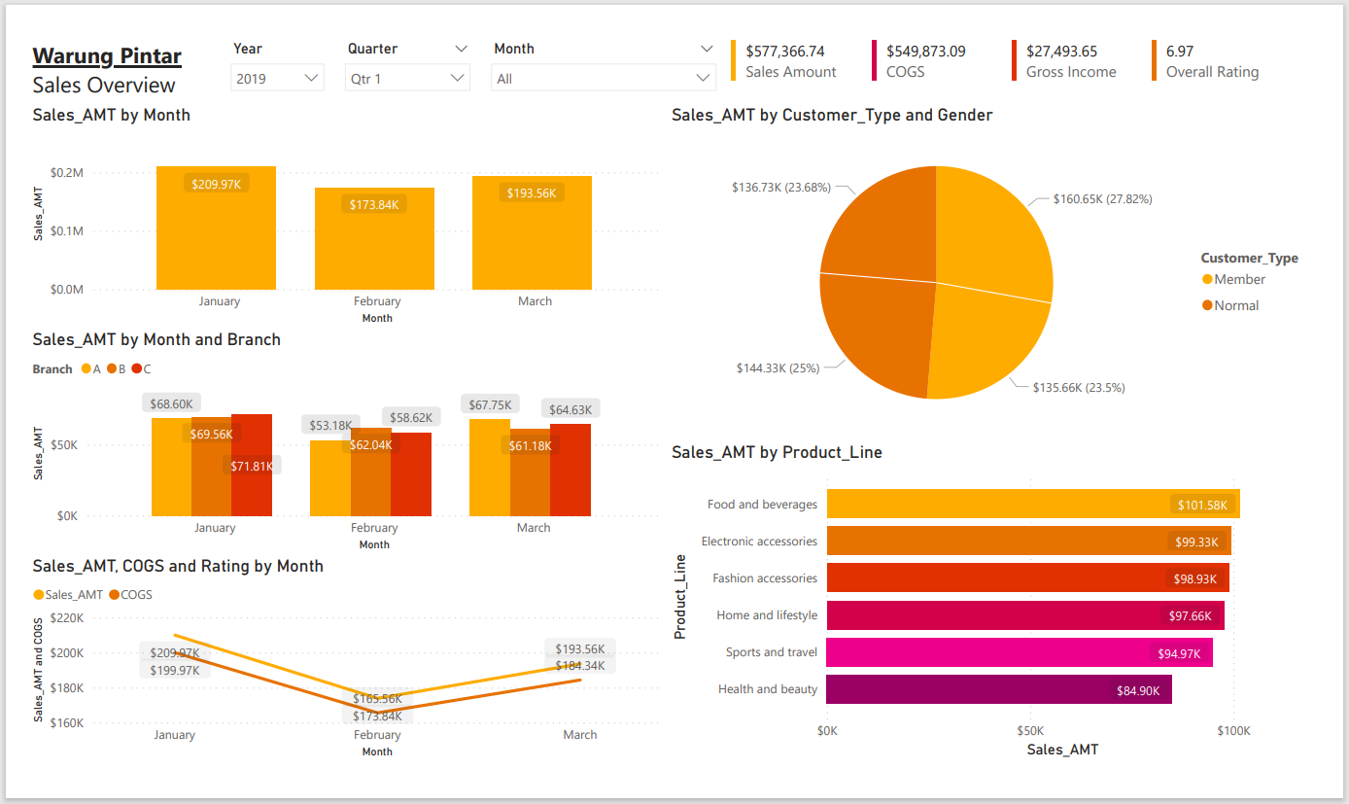
Warung Pintar Dashboard & Report
Overview Dashboard
Overall view of Sales Performance.
Date Picker for Specify the time frame.
KPI Card to quickly glance at the most important number.
Monthly Sales Trend.
Represent the proportional data of Sales by Customer.
Branch Performance.
Sales vs COGS
Top Product Line.

Slide 3
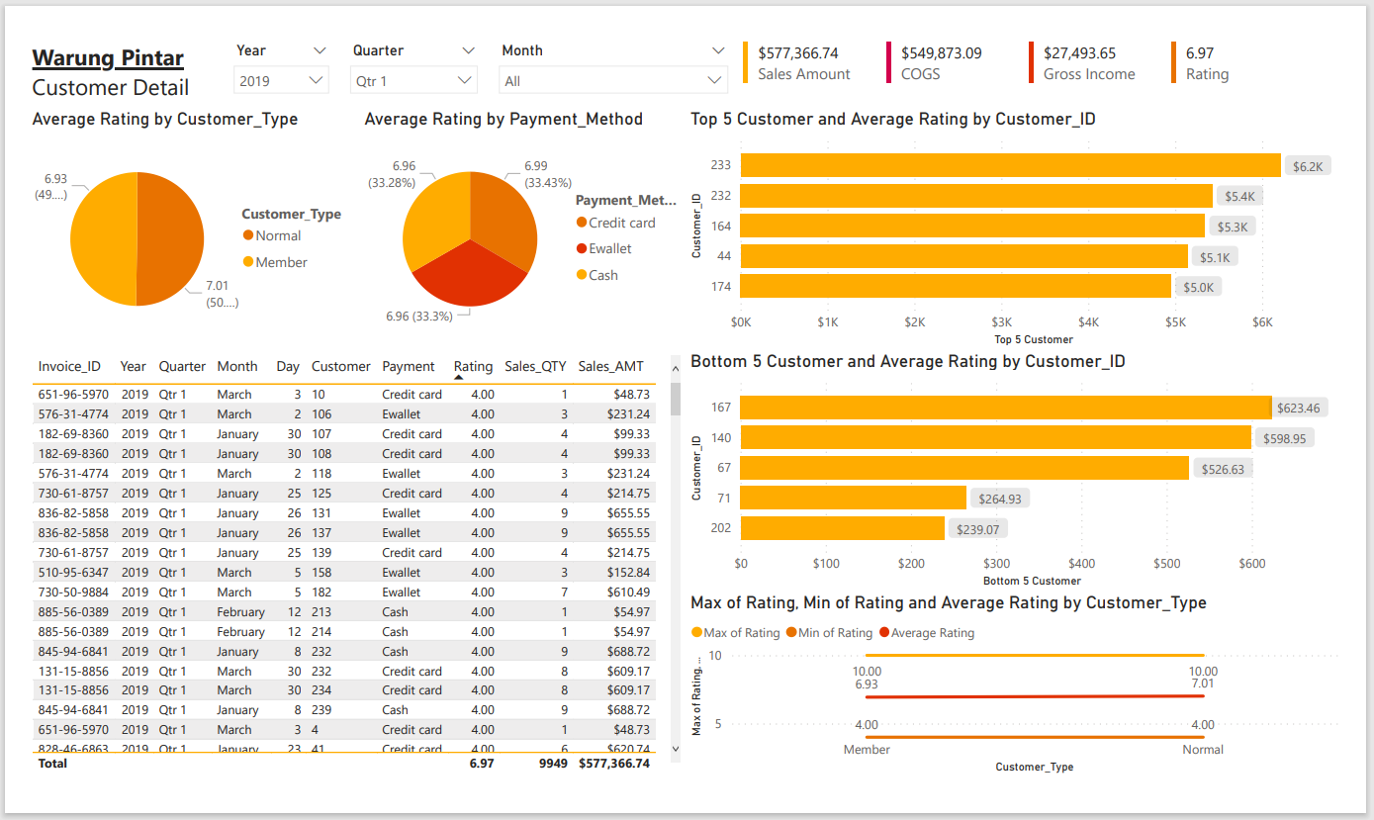
Warung Pintar Dashboard & Report
Customer Detail
In Depth view of Customer.
Date Picker for Specify the time frame.
KPI Card to quickly glance at the most important number.
Represent the proportional data of Avg Rate by Customer.
Represent the proportional data of Avg Rate by Payment.
Top 5 Customer Sales.
Bottom 5 Customer Sales.
Detail Transaction.

Slide 4
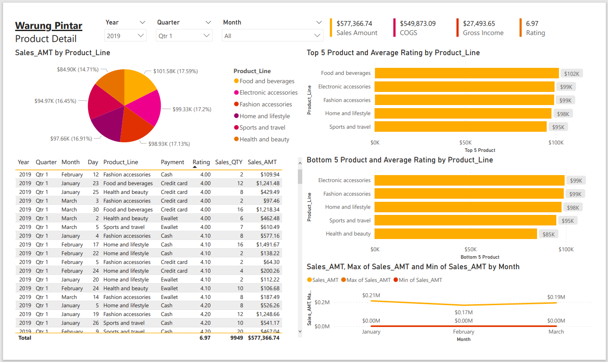
Warung Pintar Dashboard & Report
Product Detail
In Depth view of Product.
Date Picker for Specify the time frame.
KPI Card to quickly glance at the most important number.
Represent the proportional data of Sales by Product.
Top 5 Product Sales.
Bottom 5 Product Sales.
Detail Transaction.

Slide 5
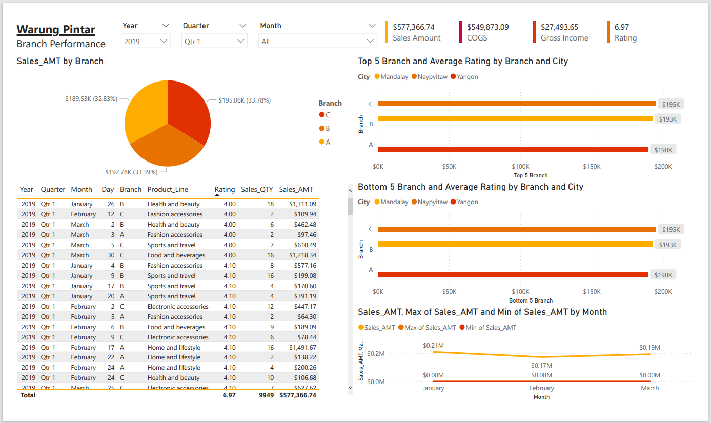
Warung Pintar Dashboard & Report
Branch Detail
In Depth view of Branch.
Date Picker for Specify the time frame.
KPI Card to quickly glance at the most important number.
Represent the proportional data of Sales by Branch.
Top 5 Branch Sales.
Bottom 5 Branch Sales.
Detail Transaction.

Slide 6
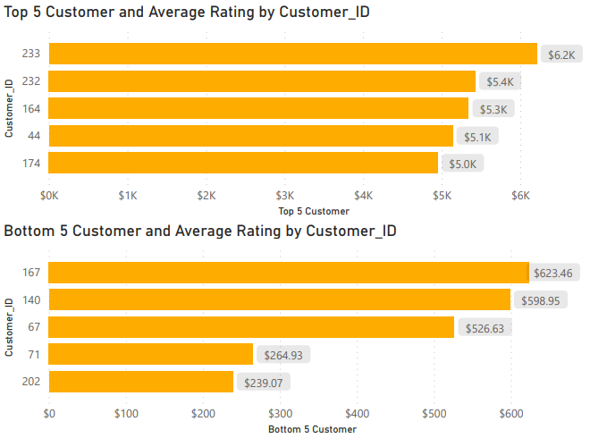
Action Plan for Current State
Actionable Insight for Top Customers
Maintaining good relation with the Top 5 customer.
Running Campaign and Promotion.
Reward Royalty.
Seek feedback from Bottom 5 Customer.
Collect and use customer data.

Slide 7
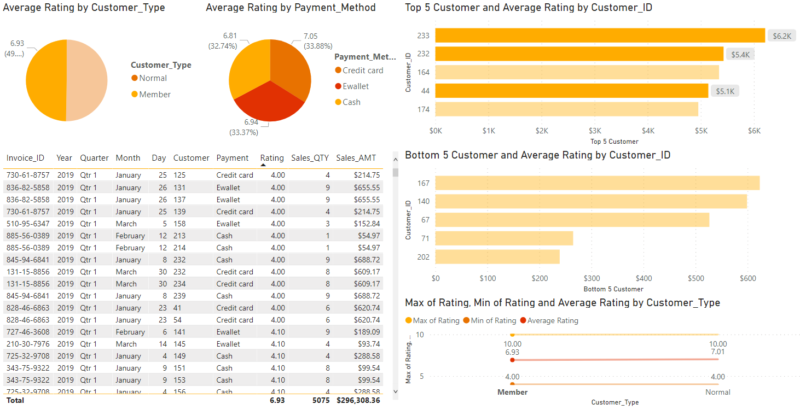
Action Plan for Current State
Improve Customer Satisfaction
Improve product or service.
Follow up with your customers.
Live chat support
Social media support
Email support

Slide 8

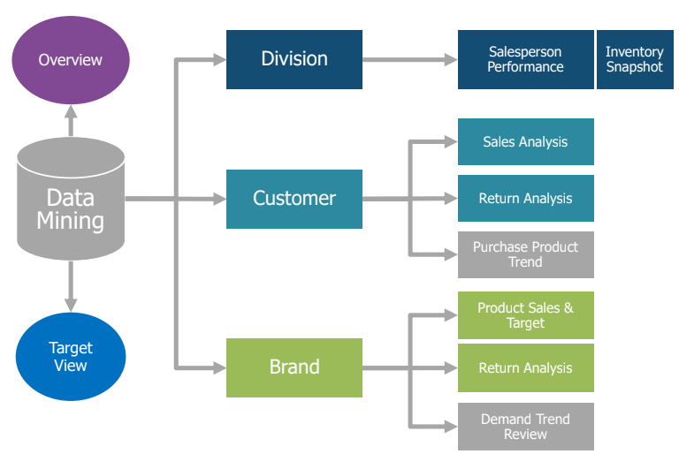
Future Plan & Improvement
GT-AD
GT-WS
CSTORE
Improve Data Framework
Improving Data Mining Framework.
Developing Channel and Sales Division.
Implementing Target to lowest level Sales Force/SKU.
DSTORE
GT-Traditional Market
GT-Warung

Slide 9
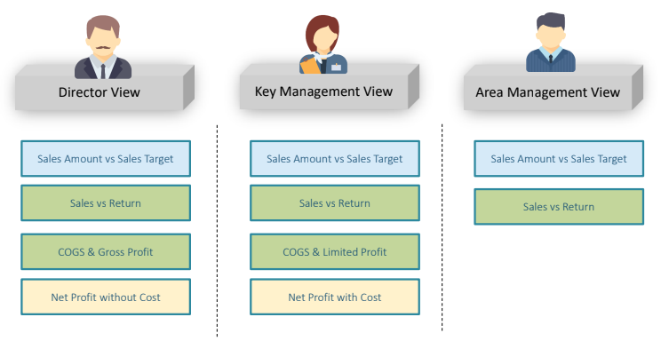
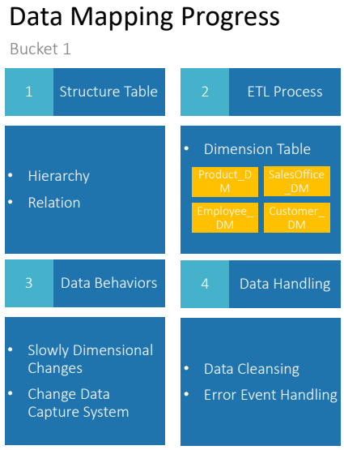
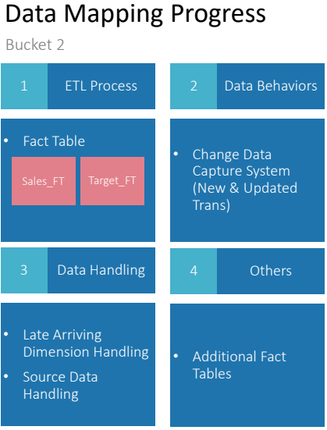
Future Plan & Improvement
Improve Dashboard
Data View By Role.
Data Mapping Process.

Slide 10
Thank You

